Slide 1
CHILDREN'S ANEMIA CASE STUDY
Wealth, Education, and Childhood Anemia in Nigeria
An Independent Analysis of the 2018 Nigeria Demographic and Health Survey (NDHS)
Saitu Yohanna

Slide 2
THE SITUATION
Child anemia is widespread in Nigeria — but the drivers aren't equal
The 2018 NDHS surveyed 30,000+ households, recording each child's hemoglobin alongside household wealth, mother's education, residence, and more.
68.8%
No investigation has yet asked which of these factors matter most — or whether they overlap.
of Nigerian children tested (ages 0–59 months) were anemic
Wealth and maternal education usually move together, so it's easy to assume one just reflects the other.
Source: 2018 NDHS, tested subsample (n = 10,182)

Slide 3
THE QUESTION
Does a mother's education protect her child against anemia even after accounting for household wealth — or is it simply a proxy for being wealthier?
WHY IT MATTERS
If education's effect is just wealth in disguise, income-focused programmes are enough. If education has its own effect, health-literacy and girls'/women's-education investment deserve a seat at the table too — often at lower cost and faster reach than income growth.

Slide 4
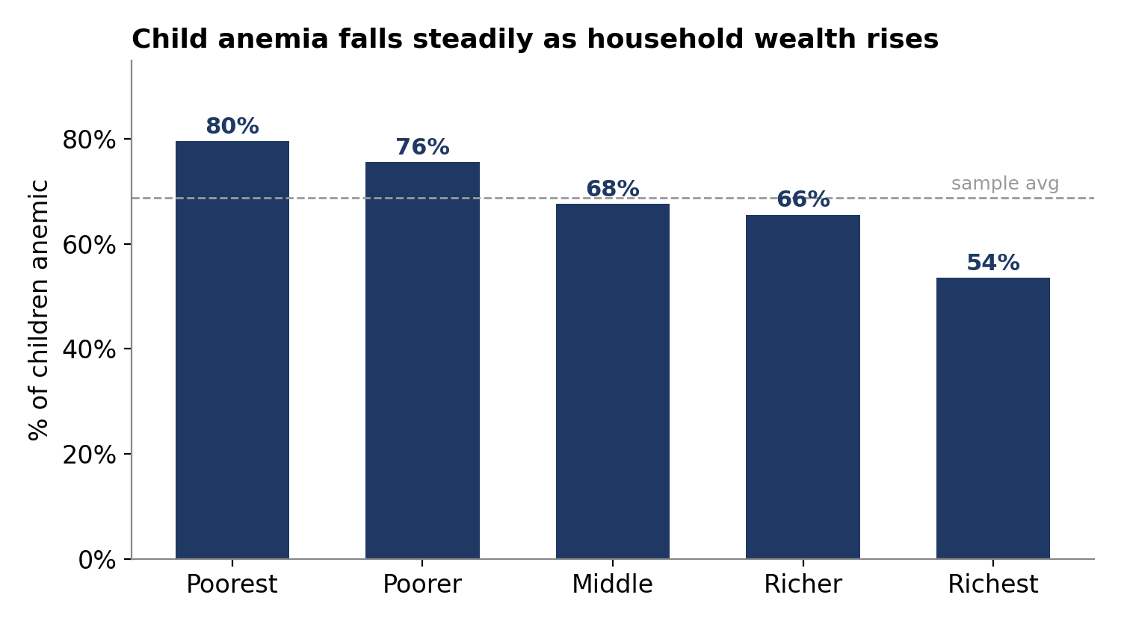
FINDING 1
Anemia falls steadily as household wealth rises
80% → 54%
Anemia drops 26 points from the poorest to the richest households.
A clear, steady gradient — but not the whole story.

Slide 5
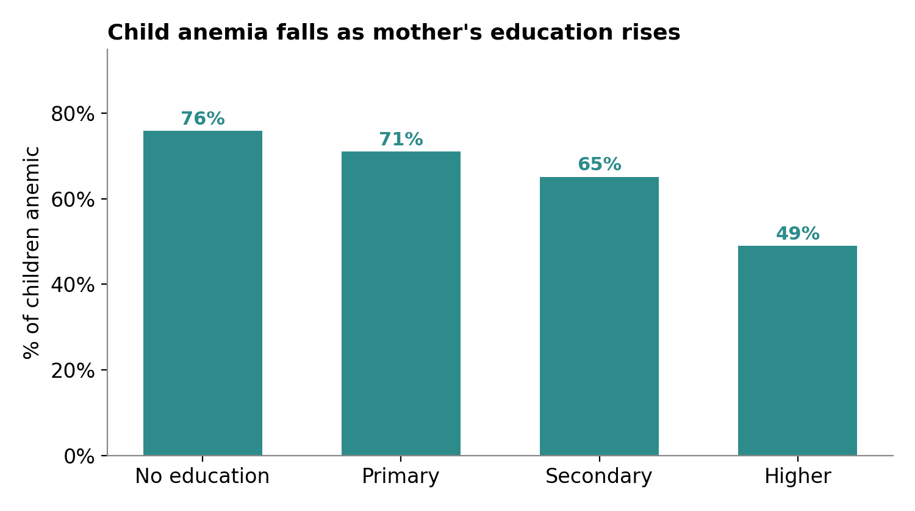
FINDING 2
Anemia falls as mother's education rises
76% → 49%
A near-identical 27-point gap appears across mother's education levels.
Wealth and education move together — so which one is actually doing the work?

Slide 6
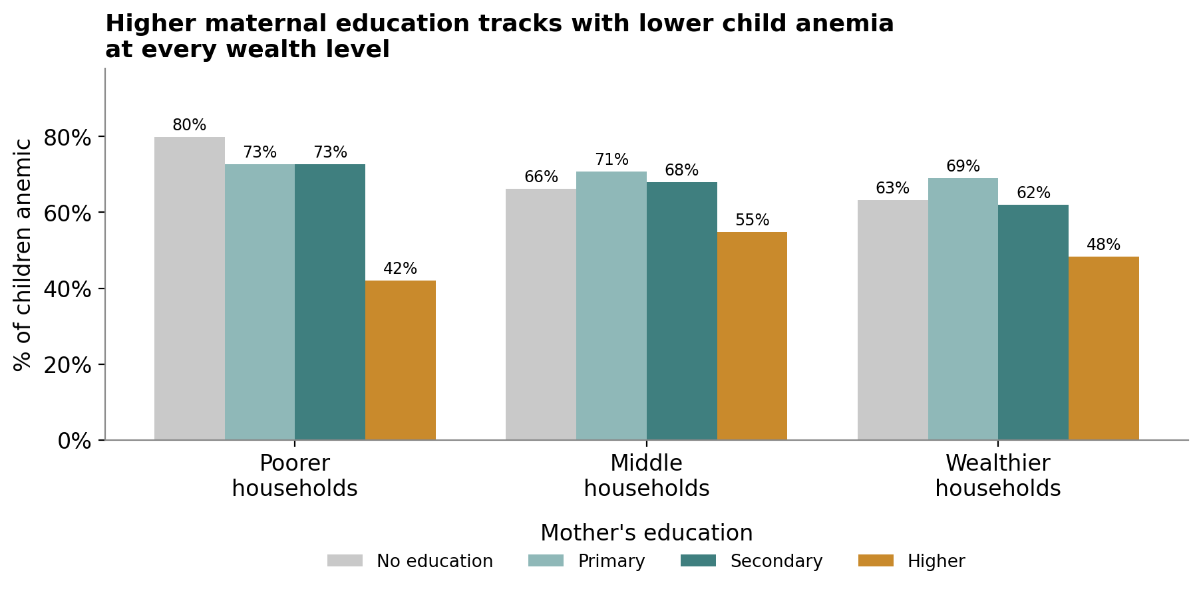
FINDING 3 — THE KEY RESULT
Higher education is protective at every wealth level
42–48%
vs. 62–80% for less-educated mothers — in the SAME wealth band.
The effect of “Higher” education holds even among the poorest households.

Slide 7
THE TAKEAWAY
Wealth and education are two separate levers — not one
Within every wealth band, children of mothers with Higher education have a markedly lower anemia rate than children of less-educated mothers at the same income level (42–48% vs. 62–80%). Both patterns are statistically significant (p < 0.001).
RECOMMENDATION
Anti-anemia strategy should not rely on income growth alone. Pairing it with maternal health-literacy and girls'/women's-education investment targets a driver that wealth improvements alone will not close.
Caveat: two wealth × education cells have small samples (n = 19 and n = 73); the direction of the pattern is consistent across all bands regardless.

